Slide 1

Web Assembly: Key Concepts and Implementation
A Technical Overview of WASM and Its Performance Benefits
By-Mohit.V
Roll Number-24CS10112

Slide 2
Motivation Behind Web Assembly
- Web applications require high performance for tasks like gaming, video editing, and simulations.
- JavaScript has limitations in execution speed and efficiency for computational-heavy tasks.
- Web Assembly provides near-native performance by allowing execution of compiled code in the browser.
Web Assembly is very useful for tasks like cryptography where time is of the essence.
Web Assembly is very useful for cloud computing , you can do serverless computing with WASM

Slide 3
What is web assembly
Web Assembly (wasm) is a simple machine model and executable format with an extensive specification.
It is designed to be portable, compact, and execute at or near native speeds.
Although it has gathered attention in the Javascript and web communities, It has no assumption about the host environment. Thus , in the near future we can speculate that it will become a portable executable format which can be used in different contexts.

Slide 4
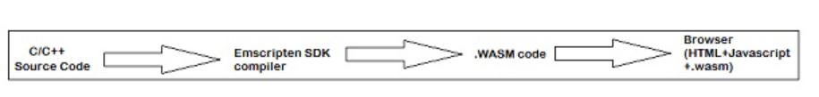
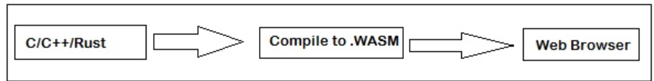
How Web Assembly Runs on a Browser
- Web Assembly runs in a secure sandboxed environment within modern web browsers.
- It works alongside JavaScript and can be called from JavaScript code.
- Uses a stack-based virtual machine to execute pre-compiled binary instructions.
Web Assembly is called in javascript which is then called in the script part of html . In this Way Web Assembly is used to run in the browser.
General compilation of Web Assembly
Compilation of Web Assembly through Rust

Slide 5
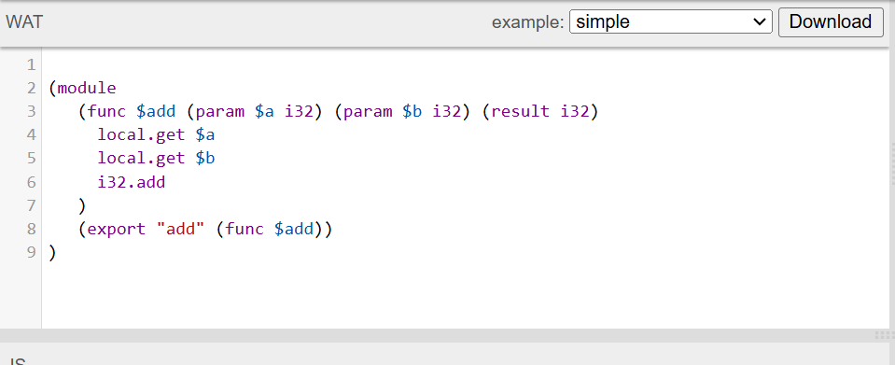
Textual Format of Web Assembly Code
- Web Assembly has a binary format (.wasm) for efficient execution.
- Also has a human-readable textual representation (.wat) using S-expressions.
- Example:

Slide 6
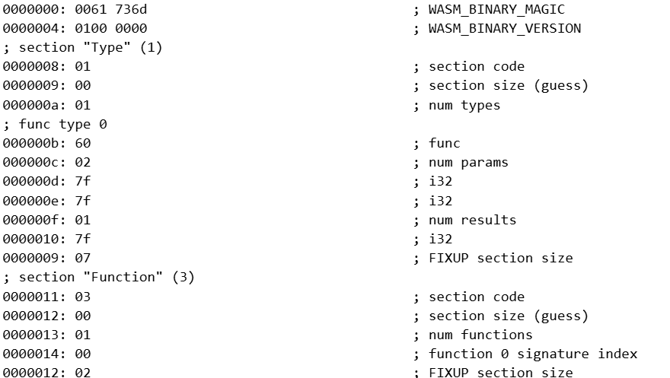
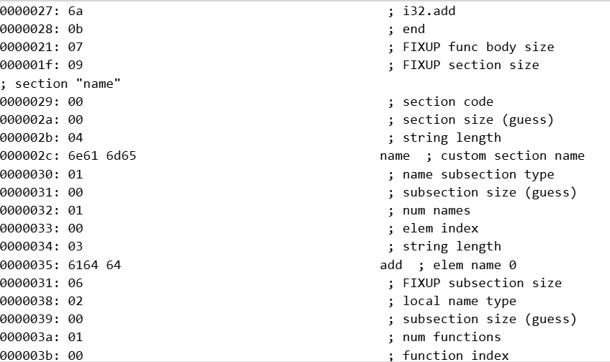
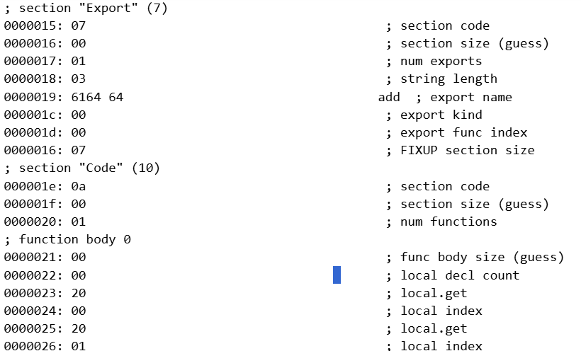
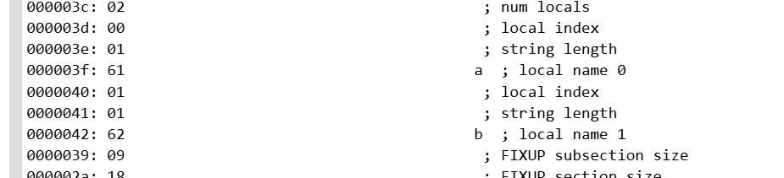
Wasm code for The given Wat code

Slide 7

Writing WASM Modules in C++/Rust
- Web Assembly modules can be written in languages like C, C++, and Rust.
This is done because web assembly wat is not easily human readable so the code is compiled in high level languages which have more resources and then compiled into .wasm format.
- Code is compiled into .wasm format using LLVM-based toolchains.
- Example (Rust):

Slide 8
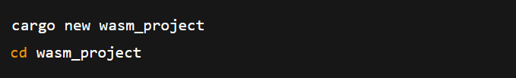
Steps To compile into WASM from Rust
First ensure you have rust installed . If not install it using Rustup:
Use this in the command line"curl --proto '=https' -- tlsv1.2 -sSf https://sh.rustup.rs | sh"
Then add the web assembly target
For that we do this:
"rustup target add wasm32-unknown-unknown"
Then we create new Rust project using the cargo function:

Slide 9
Write rust code
make the functions public to use in javascript
Compile to web assembly :
"cargo build --release --target wasm32-unknown-unknown"
The file will be in the location -"target/wasm32-unknown-unknown/release/your_project.wasm"
Install wasm-bindgen then to integrate this with javascript.
"cargo install wasm-bindgen-cli"

Slide 10
Then we use the function wasm-bindgen to integrate javascript and rust.
"wasm-bindgen --target web --out-dir wasm_output target/wasm32-unknown-unknown/release/your_project.wasm"
Alternatively-
You can run two other commands-
"cargo install wasm-pack
wasm-pack build --target web"
Then we import the code through javascript.

Slide 11
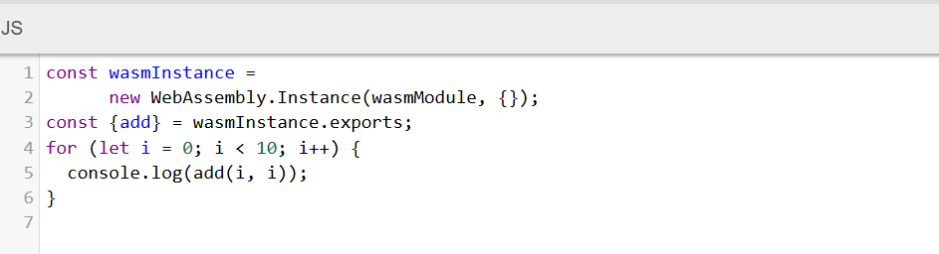
Loading and Using Web Assembly in JavaScript
- Web Assembly can be loaded and executed using JavaScript’s Web Assembly API.
- Example:
Javascript code for accessing the add function
Written in wat

Slide 12
How web assembly works in javascript
Web assembly is based on a stack machine model .
So, the input is all pushed onto the stack .
Then the input is all removed and then the output is pushed back onto the stack.
Memory in Web Assembly is an arraybuffer that holds the data. You can allocate memory by using the Javascript API WebAssembly.memory().
Web Assembly memory is stored in an array format i.e. a flat memory model that is easy to understand and perform the execution.

Slide 13
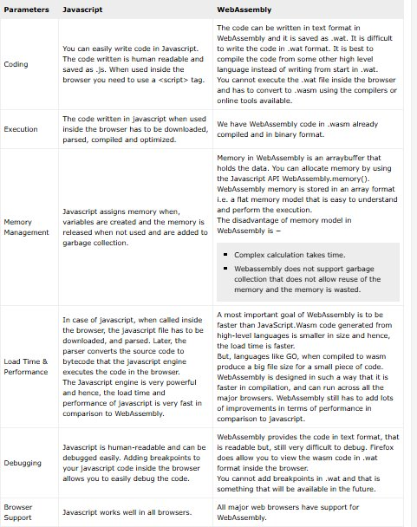
Overall Comparison : Javascript V/S Web Assembly

Slide 14
Ease to Code comparison Javascript V/S Web Assembly
Javascript:
You can easily write code in Javascript. The code written is human readable and saved as .js. When used inside the browser you need to use a <script> tag.
Web Assembly:
The code can be written in text format in Web Assembly and it is saved as .wat. It is difficult to write the code in .wat format. It is best to compile the code from some other high-level language instead of writing from start in .wat.
You cannot execute the .wat file inside the browser and you have to convert it to .wasm using the compilers or online tools available.

Slide 15
Execution Comparison Javascript V/S Web Assembly
Javascript:
The code can be written in text format in WebAssembly and it is saved as .wat. It is difficult to write the code in .wat format. It is best to compile the code from some other high level language instead of writing from start in .wat.
You cannot execute the .wat file inside the browser and has to convert to .wasm using the compilers or online tools available.
Web Assembly:
We have WebAssembly code in .wasm already compiled and in binary format.

Slide 16
Memory and Management Comparison Javascript V/S Web Assembly
Javascript:
Javascript assigns memory when, variables are created and the memory is released when not used and are added to garbage collection.
Web Assembly:
Memory in WebAssembly is an arraybuffer that holds the data. You can allocate memory by using the Javascript API WebAssembly.memory().
WebAssembly memory is stored in an array format i.e. a flat memory model that is easy to understand and perform the execution.
The disadvantage of memory model in WebAssembly is −
Complex calculation takes time.
Webassembly does not support garbage collection that does not allow reuse of the memory and the memory is wasted.

Slide 17

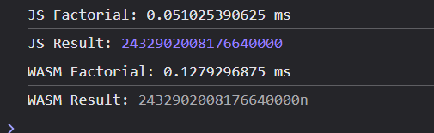

Performance Comparison: JavaScript vs Web Assembly
20 factorial
- Web Assembly executes at near-native speed, while JavaScript runs through an interpreter or JIT compiler.
however, web assembly is slower than javascript for small tasks as the transition from web assembly to javascript itself increases the time for computation.
- Benchmarks show WASM outperforms JavaScript for computationally heavy tasks.
A possible reason for this is that when a javascript file is called inside a web browser the file has to be downloaded and then parsed.Then the parser converts the code into source code .
1 to 20 factorial (100 times)
1 to 20 factorial (10,000,000 times)

Slide 18

Ease of Debugging Comparison Javascript V/S Web Assembly
Javascript:
Javascript is human-readable and can be debugged easily. Adding breakpoints to your javascript code inside the browser allows you to easily debug the code.
Web Assembly:
WebAssembly provides the code in text format, that is readable but, still very difficult to debug. Firefox does allow you to view the wasm code in .wat format inside the browser.
You cannot add breakpoints in .wat and that is something that will be available in the future.
So , it might be easier to debug in the future but at the momemt it is a difficult task.

Slide 19
Comparison of Rust Vs Web Assembly in different browsers
Browser | Web Assembly Run time | Javascript Run time
Brave | ~50ms | ~10s
Edge | ~40ms | ~10s
Chrome | ~50ms | ~10s
opera | ~40ms | ~10s
firefox | ~10ms | ~15s
We can see that the time taken for running Javascript in all the browsers is almost same.
We can see that firefox is faster compared to every other browser in terms of web assembly run time.
This can probably be attributed to the fact that firefox is one of the front runners in compiling of web assembly. Due to this, the integration of web assembly features is more efficient .

Slide 20
Challenges and Limitations of Web Assembly
Debugging Web Assembly is very difficult and that is a major problem.
Tools for Web Assembly need to be improved.
There is a problem in the memory model which needs to be fixed.
There are also security concerns related to web assembly

Slide 21
Thank You!

